Slide 1
Introducing the latest project of The Web Divers
company plAN
COMPANY PLAN
SYSTEM ANALYSIS
CONCLUSION
USED TECHNOLOGY
INTRO
G0ALS & OBJECTIVES
SYSTEM DESIGN
REQUIREMENTS
FUTURE ENHANCEMENT
A Web Based
Hall Management system

Slide 2



This project deals with the problems of managing a hall that is carried out by manual entry of hall data.
It helps to know and manage:
COMPANY PLAN
SYSTEM ANALYSIS
INTRO
CONCLUSION
USED TECHNOLOGY
REQUIREMENTS
2017
2017
2017
2017
2016
2015
2014
SYSTEM DESIGN
FUTURE ENHANCEMENT
GOALS AND 0BJECTIVES
2013
Student Details
Staff Details
Hall Bills
Grocery Details

Slide 3
GOALS & OBJECTIVES
Goal :
The main goal of the project is to design an application which allows the admin to easily handle the data regarding the hall and students.
Objective :
Objectives of Hall Management System:
COMPANY PLAN
SYSTEM ANALYSIS
CONCLUSION
2017
USED TECHNOLOGY
2017
REQUIREMENTS
2017
2017
2016
2015
2014
SYSTEM DESIGN
FUTURE ENHANCEMENT
GOALS AND 0BJECTIVES
To maintain and manage the hall information easily.
To avoid the complexity and to reduce time in data processing.
To provide data access through the users and students according to their roles and authority.

Slide 4
The Limitations of Existing System:
Limited data availability
Update complexities
COMPANY PLAN
SYSTEM ANALYSIS
CONCLUSION
USED TECHNOLOGY
1
2
3
REQUIREMENTS
2017
2016
2017
2015
2017
2017
SYSTEM DESIGN
FUTURE ENHANCEMENT
More time consuming process

Slide 5
The Main Advantages Of The Proposed System Are:
Easy Data Availability
Easy Data Accessibility
COMPANY PLAN
CONCLUSION
2017
USED TECHNOLOGY
2017
REQUIREMENTS
2017
2016
2017
2015
SYSTEM DESIGN
FUTURE ENHANCEMENT
SYSTEM ANALYSIS
Reduces The Time As Well As Manpower
Easy Announcement

Slide 6






CSS
HTML
PHP
COMPANY PLAN
CONCLUSION
JavaScript
REQUIREMENTS
2017
2017
2017
2016
2017
USED TECHNOLOGY
SYSTEM DESIGN
FUTURE ENHANCEMENT
Data Encryption
(Password Hash)
MySQL

Slide 7
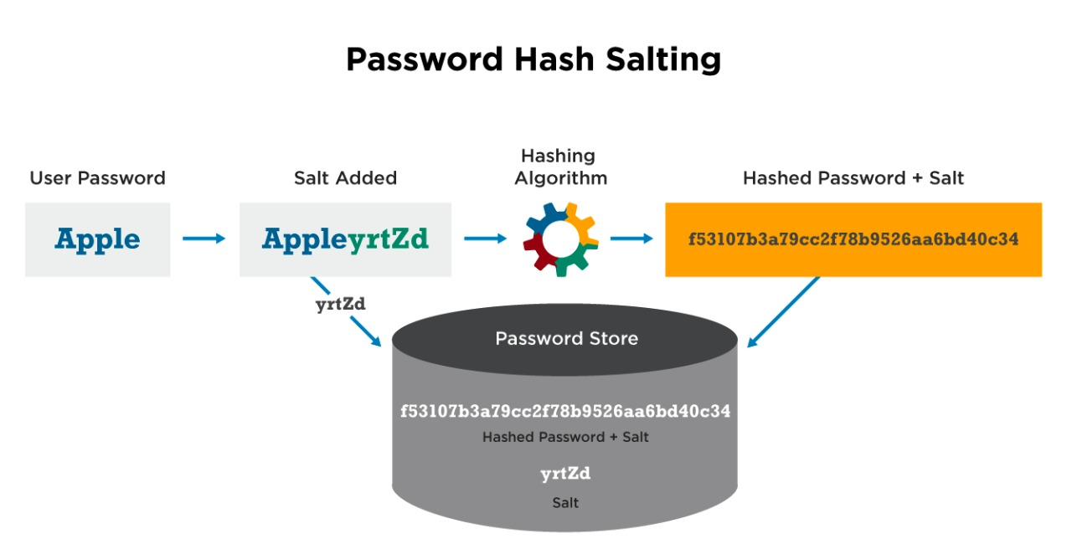
PASSWORD HASH
COMPANY PLAN
CONCLUSION
REQUIREMENTS
2017
2017
2017
2016
2017
USED TECHNOLOGY
SYSTEM DESIGN
FUTURE ENHANCEMENT

Slide 8




Things Needed To Run This Software:
COMPANY PLAN
CONCLUSION
2017
2017
2017
2017
REQUIREMENTS
SYSTEM DESIGN
FUTURE ENHANCEMENT
PC
Gateway Merchant Ship
(Optional)
Internet Connection
Printer

Slide 9
Our Hostel Management has three different interfaces depending upon the role of the users
Super Admin
Students
COMPANY PLAN
2017
2017
2017
CONCLUSION
FUTURE ENHANCEMENT
SYSTEM DESIGN
SYSTEM DESIGN
1
2
3
Dining Committee

Slide 10
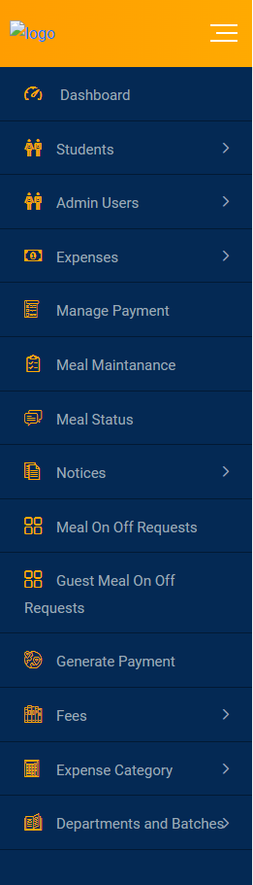
Admin Interface:
It's the work station of a super admin. He can inspect and modify everything from here.
COMPANY PLAN
CONCLUSION
2017
2017
2017
FUTURE ENHANCEMENT
FUTURE ENHANCEMENT
SYSTEM DESIGN

Slide 11
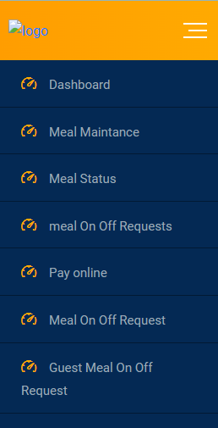
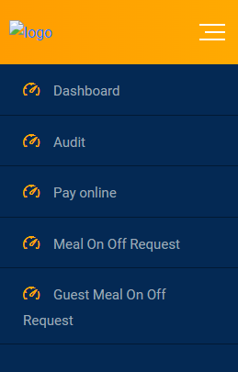
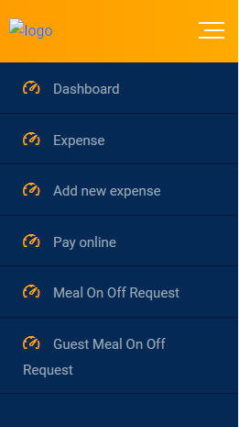
Dining Committee Interface:
Meal Checker:
Meal Auditor:
Manager:
COMPANY PLAN
CONCLUSION
SYSTEM DESIGN
2017
2017
2017
FUTURE ENHANCEMENT

Slide 12
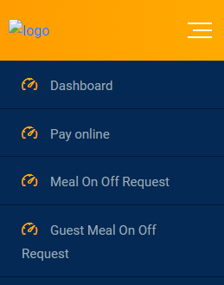
Student Interface:
Using this interface, a general student is able to observe and manage his actions with hall regarding subjects.
COMPANY PLAN
CONCLUSION
SYSTEM DESIGN
2017
2017
2017
FUTURE ENHANCEMENT

Slide 13





IT Connectivity
Easier to Operate
Digital Management
COMPANY PLAN
2017
2017
CONCLUSION
FUTURE ENHANCEMENT
User Friendly
Time Efficient

Slide 14
Our Visions With This Project
Counter System
Canteen System
2
4
COMPANY PLAN
2017
FUTURE ENHANCEMENT
1
3
Payment Automation
Barcode System

Slide 15
Our future projects
Our Visions with this project
Admission Management
Learning Management
Counter System
Canteen System
2
2
4
4
COMPANY PLAN
1
1
3
3
School Management
Library Management
Barcode System
Payment Automation

Slide 16
Thank You
Presentation by:
The Web Divers
-We dive into the web to connect the world
We dive into the web to connect the world

